Slide 1

Saginaw County MA PPO Benefits
Medicare Plus Blue℠ is a PPO plan with a Medicare contract. Enrollment in Medicare Plus Blue depends on contract renewal
10/2018

Slide 2

Agenda
Medicare basics
Key terms
Using your plan
Health and Wellness
Additional benefits in your plan

Slide 3
Medicare basics

Slide 4
Medicare basics
WHAT’S INCLUDED
PART
A
PREMIUM
Hospital care
Skilled nursing facility care
Hospice
Home health care
There is no charge for people who have at least 40 work credits

Slide 5
Medicare basics
WHAT’S INCLUDED
PART
B
PREMIUM
Doctor visits
Mental health care
Outpatient surgery
Lab tests
Durable medical equipment
You must pay your Part B premium every month
Your premium depends on when you first signed up and your income

Slide 6
Medicare basics
WHAT’S INCLUDED – Medicare Advantage
PART
C
Original Medicare benefits
Original Medicare rights & protections
Original Medicare covered service
Extra benefits
  Silver sneakers
  Care management services
You must continue to pay your monthly Part B premium

Slide 7
One Card
One Explanation of Benefits
One Claims Processing
Once Customer Service
1

Slide 8
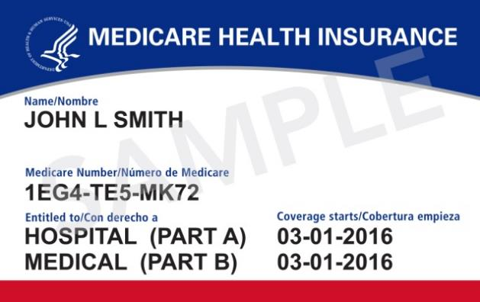
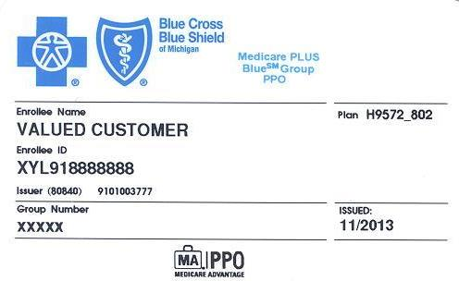


Membership confirmation and ID card
Put your red, white and blue Medicare card in a safe place – you only need your Blue Cross ID card for your medical services. You will be getting a new Medicare card in the mail April 2018 – 2019.

Slide 9
Saginaw County plan benefits

Slide 10
Key Terms
Deductible
The amount you pay before your plan begins to pay its share.
Coinsurance
The percentage of the cost of the service that you pay.
Copayment
A fixed dollar amount you pay to health care providers each time you use their services, such as an office visit.
Out-of-Pocket Maximum
The most you have to spend for copays, coinsurance and deductibles in any given year.

Slide 11
Deductible, coinsurance and dollar maximums
 | In network | Out of network
Annual deductible per member per year | $
Coinsurance | % coinsurance
Copayment | $
Out-of-pocket maximum | This is a safety net to ensure you do not pay more than $ in copays in one year

Slide 12
Preventive Services
 | In network | Out of network*
Welcome to Medicare exam | Covered at 100%
Routine physical
Pap smear and prostate cancer screening
Cardiovascular, diabetes and HIV screening
Immunizations
Mammography
Bone mass measurement | Covered at 100%
Colorectal cancer screening
*Out-of-network/non-contracted providers are under no obligation to treat Medicare Plus Blue PPO members, except in emergency situations. For a decision about whether we will cover an out-of-network service, we encourage you or your provider to ask us for a pre-service organization determination before you receive the service. Please call our customer service number or see your Evidence of Coverage for more information, including the cost-sharing that applies to out-of-network services.
This information is not a complete description of benefits. Contact the plan for more information. Limitations, copayments and restrictions may apply. Benefits, provider network, premium and/or copayments/coinsurance may change on January 1 of each year.
You must continue to pay your Medicare Part B premium.

Slide 13
Plan Benefits
 | In network | Out of network*
Office visits (Primary care doctor) | $ copay
Specialist visits (No referral required) | $ copay
Chiropractic manipulations | $ copay
Emergency care | $ copay (copay waived if admitted)
Urgent care | $ copay
Ambulance services (if medically necessary) | % coinsurance

Slide 14
Prescription Drugs
Retiree Benefits | 2018 Preferred RX Cost Share | 2019 Preferred RX Cost Share
Option 4, $10/$40/$80 | $5/$35/$75 | $4/$30/$70
Option 7, $10/$40/$80 | $5/$35/$75 | $4/$30/$70
Option 8, $2/$40/$80 | $1/$35/$75 | $1/$30/$70
Option 9, $0/$40/$80 | $0/$35/$75 | $0/$30/$70
Option 10, $5/$40/$80 | $1/$35/$75 | $1/$30/$70
Option 11, $3/$40/$80 | $1/$35/$75 | $1/$30/$70

Slide 15
2019 Sample of Preferred Pharmacies
Note: This list includes Michigan preferred chains only. This list is subject to change and doesn't include independent chains or preferred chains that participate outside of Michigan.
Costco Pharmacy
D & W Pharmacy
Family Fare Pharmacy
Felpausch Pharmacy
Glen’s Pharmacy
Kmart Pharmacy
Kroger Pharmacy
Meijer Pharmacy
Rite Aid Pharmacy
Sam’s Club Pharmacy
Shopko Pharmacy
VG’s Pharmacy
Walgreens Pharmacy
Walmart Pharmacy
Notes:
Beginning Jan. 1, 2018, Blue Cross Blue Shield of Michigan and Blue Care Network's Medicare Advantage
plans will enhance their pharmacy network with Express Scripts’ new Medicare Preferred Value Network.
This change will help Blue Cross and BCN better control premium costs and maintain member benefits
due to rising pharmacy prices.
This new pharmacy network will offer standard and preferred pharmacies to Medicare Advantage
members. This means members will be able to select a preferred pharmacy for all their prescriptions,
providing greater savings on monthly and 90-day prescriptions, especially if Medicare Advantage
members choose preferred pharmacies.
• All prescriptions filled at a preferred pharmacy will be eligible for reduced cost savings — not just the
32- to 90-day extended supplies.
• The lower cost shares were developed based on each group’s current benefit design, which means
they could vary by:
◊ Tiered copays
◊ Coinsurance amounts
◊ 90-day multipliers
• You can make small changes to the preferred copays. The differential between the preferred and
standard must remain the same.
• Retirees will be notified about this change in their Annual Notice of Change and Evidence of
Coverage. But you have the option to let the retirees know in advance.
• All groups will adopt the new pharmacy benefit change. The preferred pharmacy design provides a
lower cost share for preferred pharmacies.
• Groups aren’t losing any benefits. In fact, benefits will be enhanced by a lower cost share at preferred
pharmacies and by extending the lower preferred member cost share to one to 31-day supplies.
Confidence comes with every card.®
Medicare Plus BlueSM and Prescription BlueSM are PPO and PDP plans with a Medicare contract.
Enrollment in Medicare Plus Blue and Prescription Blue depends on contract renewal.
Blue Cross Blue Shield of Michigan and Blue Care Network are nonprofit corporations and independent
licensees of

Slide 16
Flu Shot
Benefit | At the Doctor’s Office | At the Pharmacy
Medical Benefit (Part B) | Members can receive their flu vaccine at their doctor’s office (in state or out of state). BCBSM Medicare Advantage PPO plans provide full coverage for the influenza vaccine with no member cost share. | In State: Members can receive their flu vaccine at participating pharmacies that directly bill BCBSM. The following pharmacies will direct bill BCBSM, with no out of pocket cost to the member: Walgreens, Rite Aid, CVS (CVS in Target), Meijer, Kroger and Kmart. Out of State: If the out of State Pharmacy has the ability to bill BCBSM. The flu shot is covered at 100% of the approved amount. If the out of state pharmacy cannot bill the Medicare Advantage Plan directly, the member can pay up front and submit the bill for reimbursement.
Additional Information | Please note: At the doctor’s office members may be responsible for an associated office visit charge if other services are provided during your office visit. | Member should submit their receipt along with a completed claim form to: BCBSM Imaging and Support Services P.O. Box 432593 Detroit, MI 48232-0593

Slide 17


When you travel
Blue Cross Blue Shield of Michigan gives you access to providers anywhere in the United States.
Your benefits travel with you anywhere in the United States and its territories. Call customer service to find a provider wherever you are.
When traveling outside of the United States, in some instances, you will have to pay for your emergency and urgent care and get a refund from us.
You’re covered for emergency and urgent care worldwide.

Slide 18


How to find a participating provider
Call: the customer service number on the back of your card (TTY users please call 711)
Click: Go to www.bcbsm.com/medicare, click on “Find a Doctor”
Ask: You can also call your provider’s office and speak to the billing department. You can ask, “Do you participate with the Medicare Advantage PPO plan offered by Blue Cross Blue Shield?
?

Slide 19
Value of a primary care physician
Medicare does not require PPO members to have PCP, but they can serve a valuable role.
Examples of primary care physicians include:
  Family Practice
  Internal Medicine
  Nurse Practitioner
To know you and your health: Your PCP can recognize changes in your health and what it means
To expertly guide your care through the PPO network
  Your PCP can help you identify other doctors or specialists you need and brief them on your health
  They also monitor the big picture of your health, while specialists will manage more focused needs

Slide 20
Manage your costs
Track your treatment and the amounts you have paid throughout the year
  Use the Member Portal
  Download the Mobile App
Register for and check http://www.bcbsm.com/medicare to monitor claims status
Allow time for the claim to be processed
  Typically 30 to 60 days from date of billing
Compare doctor’s bill to your Explanation of Benefits statement
  Make sure your out-of-pocket costs are the same
Reach out early if you have questions
  Call our Customer Service team at 888-322-5616 or
  Access your account online (once you’re signed up)

Slide 21

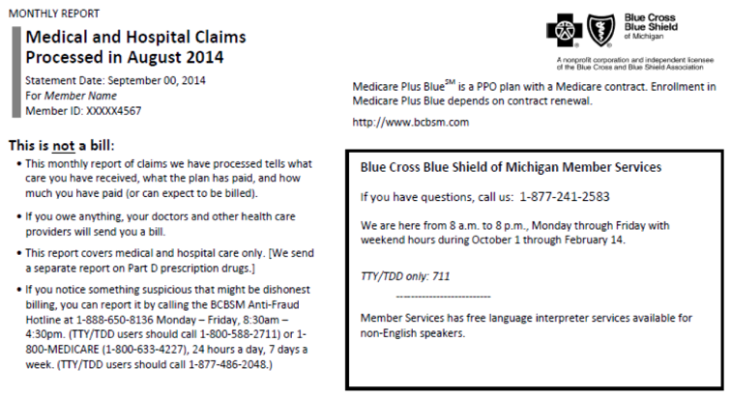
Explanation of Benefits payment
Is not a bill
Summarizes the total cost of the medical services you received.
Shows you what your health care provider billed us, what we paid the provider and what your share of the cost is.
Explains what your deductible and yearly out-of-pocket maximums are and how much your have paid towards them.
Sent monthly, if you receive services

Slide 22
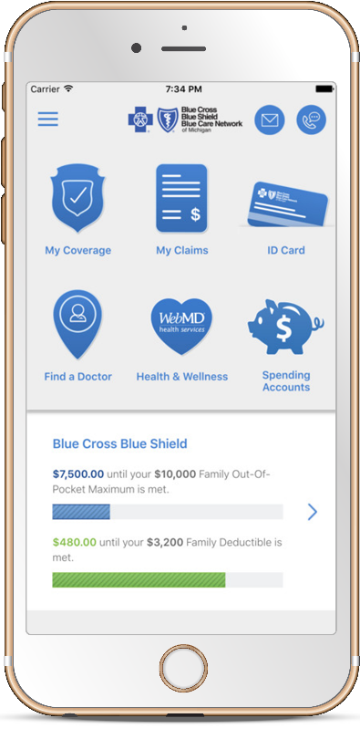
Download the BCBSM Mobile App
The most convenient way to stay informed about your plan any time of the day. With the app you can:
  Track your costs
  Check on claims
  Find a doctor
  …and more
How to get the app
  It's available in the App Store® for iPhones and Google Play™ for smartphones using Android.
  The app is not yet available for tablets.

Slide 23
Blue Cross
Health & Wellness ®

Slide 24


Call the Blue Cross Engagement Center for access to these programs
Our knowledgeable specialists are here to answer your questions about any of the programs or services offered through Blue Cross Health & Wellness.
We can help:
Coordinate any program referrals
Find personal or specialist doctors
1-800-775-2583
MON-FRI, 8 a.m. – 6 p.m., Eastern
TTY users please call 1-800-240-3050

Slide 25


Chronic condition management
A personal nurse manager can help you if you have:
Coronary artery disease
Chronic obstructive pulmonary disease
Diabetes
Heart failure
Once you’re in the program, your nurse can support your health care needs by:
Reviewing your health
Creating a personalized care plan for you
Identifying health goals and building skills
Helping you recognize symptoms and respond to warning signs
Identifying additional care you may need
Working with your regular doctor

Slide 26
Case management
A serious illness can feel overwhelming and we’re here to help you. Rely on our registered nurses who will work with you, your family and your regular doctor to:
  Coordinate care
  Inform you about your condition and treatment options
  Help with community resources
  Find specialty medical devices and equipment

Slide 27
Blue Care Connect℠
Blue Care Connect is your connection to the extra support you might need if you have complex care needs.
A nurse will call you to work with you to meet your goals, help you feel comfortable and:
  Help you manage your condition
  Coordinate your care
  Inform you about your care and treatment options
  Coordinate the delivery of medical supplies and equipment
  prescribed by your doctor
  Coordinate home visits as needed
  Help with community resources

Slide 28
Care transition to home
Our goal is your full recovery and continued good health! Most people don’t feel 100 percent perfect when leaving a hospital. The first 30 days after a hospital stay are critical to a full recovery.
When you are discharged from a hospital or skilled nursing facility, a Blue Cross nurse will call you to:
  Make sure you have the medications you need and that you know how and when to take them
  Explain the signs of possible complications or worsening symptoms so you get the help you need
  Follow up with your doctor as appropriate
  Make sure you have the support and resources you need to maintain your health

Slide 29
24-Hour Nurse Line
A registered nurse health coach is available to you 24 hours a day, seven days a week if you have health questions, want information to help you make a medical decision or need support with managing a chronic condition.
SAFE. One-on-one conversations with a registered nurse. Caring. Confidential.
QUICK. Expert health advice by phone. No Web searches. No waiting.
EASY. Connect from home or on the go. No appointments. No cost. No hassle.
1-800-775-BLUE (2583).

Slide 30

Tobacco cessation program
Our tobacco cessation program is a free
12- month telephone-based support program.
A personal health coach helps you develop an action plan to quit smoking or using tobacco.
Tobacco Cessation Coaching offers:
  Unlimited telephone access to your
  dedicated health coach
  Personal plan for quitting
  Online resources

Slide 31
Welvie℠ surgery decision-support
You have access to WelvieSM, a surgery decision-support program to help you explore your treatment options. It's available to you at no additional cost.
Welvie is an internet based program that walks you through the surgery decision process. It provides a unique, step-by-step approach from diagnosis to recovery.
Visit welvie.com* and click on I am ready to log in and then click on register now.
Even if surgery isn’t in your immediate future, check out Welvie so you’re prepared if you’re ever faced with a surgery decision.
**Welvie is an independent company retained by Blue Cross Blue Shield of Michigan to provide a surgery decision-support program to select Blue Cross Medicare Advantage members.

Slide 32


Blue365®
Blue 365 offers exclusive health and wellness deals, keeping you healthy and happy, every day of the year! As a member of Blue Cross’ Medicare Plus Blue PPO, you automatically have access to nationwide discounts. Visit www.blue365deals.com

Slide 33

SilverSneakers®* fitness program
Program benefits:
Membership in a network of health clubs and exercise classes
15,000 participating U.S. locations (no restrictions on days and times
Classes designed just for you
Exercise at your own pace with people in your age group
Program advisors at each location to help you get started
Online support to help you lose weight, reduce stress
Walking programs and home fitness programs
*SilverSneakers is a registered trademark of Tivity Health, an independent company that provides services to Blue Cross Blue Shield of Michigan Medicare Plus Blue Group PPO members.
Visit:
www silversneakers.com
for participating locations.
Or call:
1-888-423-4632,
Monday through Friday,
8 a.m. to 8 p.m. Eastern time. TTY users call 711.

Slide 34


Customer Service
  Request a new Blue Cross ID card
  Locate a provider
  Answer personal account questions
  Assist with benefit questions

Slide 35

Thank you for coming!
Our commitment to you: We work hard to be clear and simple, to help you make the right choices, to offer valuable coverage, and help you get quality health care for you and those you love.

